Slide 1
Cng 562 Machine learning
Nisa Nur Odabaş
Kaan Taha Köken

Slide 2
Outline
Experiment
Final Model
ROC
Conclusion

Slide 3

Experiment
Spliting up dataset into train and test sets.
Using data
Raw
L1 normalization
Mean removal
Validation
Random 1-hold out
Stratified 1-hold out
5-Fold
10-Fold
Predictor model
Linear regression
Logistic regression

Slide 4
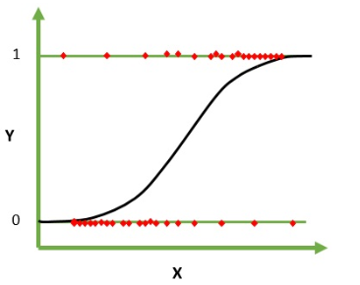
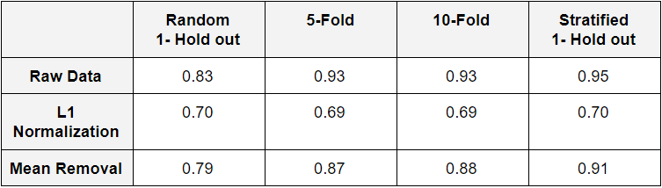
Experiment
Logistic Regression Accuracies

Slide 5
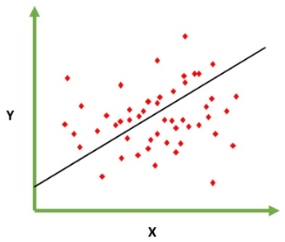
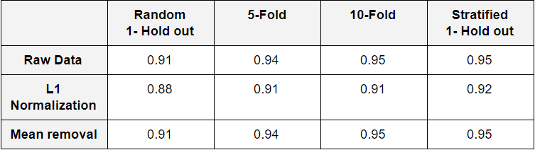
Experiment
Linear Regression Accuracies

Slide 6


Final Model
Raw data
Stratified 1-hold out
Linear regression

Slide 7
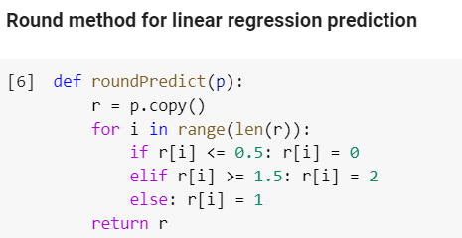
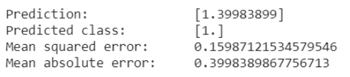
Final Model
Prediction of [6 3 5 1.5]

Slide 8
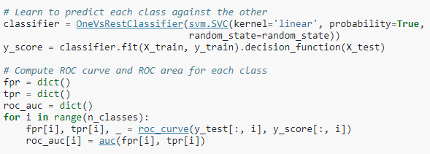
ROC
Sample code for multiclass ROC

Slide 9
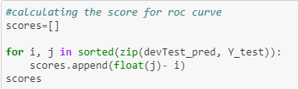
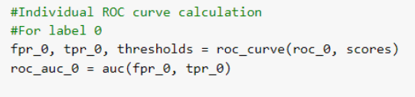
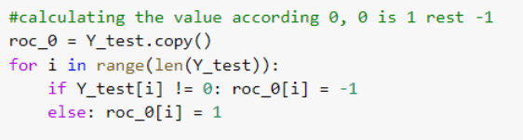
ROC
1- Score calculation
3- ROC calculation
2- One vs rest logic

Slide 10
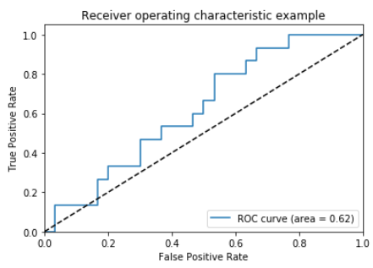
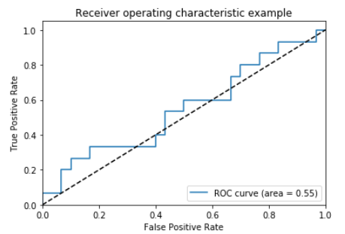
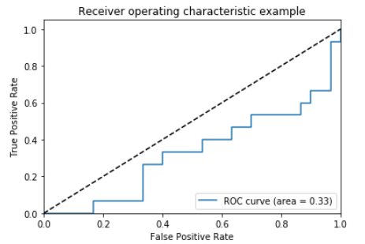
ROC
Linear Regression
Class 0 Class 1 Class 2

Slide 11
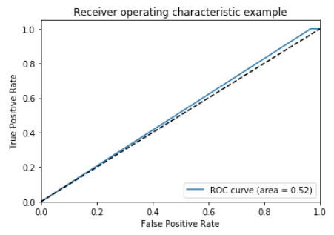
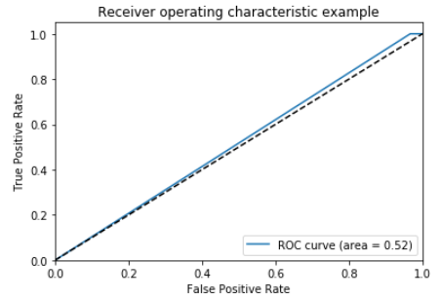
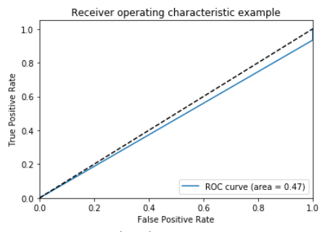
ROC
Logistic Regression
Class 0 Class 1 Class 2

Slide 12
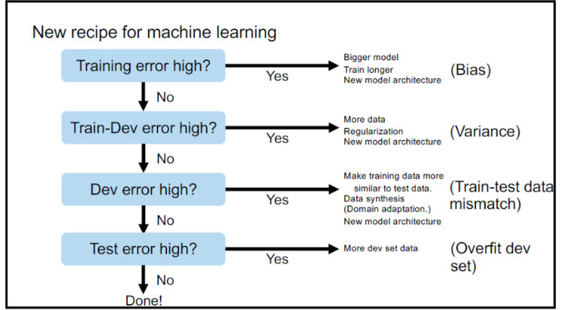
Conclusion

Slide 13
Thank You

